Slide 1







SREC IPL’2K26
proudly presents
Smart Management System for Hospital
IT STARS
MEMBERS
RITHIK M.E - 71812305126 SANJAI K - 71812305129 TAMILARASU V - 71812305146
MENTOR NAME S DESIGNATION MRS.S.S.SUGANTHA MALLIKA ASSISTENT PROFESSOR(SL.GR) /IT

Slide 2



ABSTRACT
The Smart Hospital Management System is a web-based solution that simplifies hospital operations by replacing manual processes with a digital platform. It enables online appointment booking, secure record management, and efficient coordination between patients, doctors, and administrators.
A key feature of the system is anonymous mental health consultation, allowing patients to seek support privately. An integrated chatbot further improves user interaction and guidance.
The solution enhances efficiency, reduces waiting time, ensures data security, and promotes accessible and inclusive healthcare services

Slide 3
TECHNICAL APPROACH
Technologies Used
Frontend: HTML, CSS, JavaScript Backend: Python with Flask framework Database: MySQL (Relational Database) Tools: VS Code, XAMPP / Local Server
Architecture: Client–Server Web Architecture
Methodology S Implementation Process Requirement Analysis and System Planning Database Design (ER Diagram & Table Structure) Backend Development using Flask
Frontend UI Design and Integration
Module Implementation (Admin, Doctor, Patient, Anonymous Booking, Chatbot) Testing, Debugging, and Performance Optimization
Final Deployment on Local/Cloud Server Working Flow
User → Login/Register → Select Service → Book Appointment → Data Stored in Database → Doctor/Admin Access & Manage The system follows a modular and structured development approach to ensure scalability, security, and smooth performance.

Slide 4
FEASIBILITY AND VIABILITY
Feasibility
The proposed system can be developed using standard web technologies that are affordable and widely supported. It requires only basic server infrastructure and can function in both small clinics and large hospitals. The platform is designed to be expandable, making it suitable for future growth and upgrades.
Challenges
Ensuring confidentiality of medical data
Encouraging users to shift from manual to digital methods Handling technical issues and system maintenance
Solutions
Implement secure authentication and protected data storage Design an easy-to-use interface with proper guidance Perform regular monitoring, updates, and data backups
The idea is realistic, sustainable, and capable of being implemented in real healthcare settings.

Slide 5


IMPACT AND BENEFITS
Impact on Target Audience
The system improves access to healthcare services by allowing patients to book appointments easily and avoid long waiting times. Doctors and administrators benefit from organized digital records and better schedule management. The anonymous consultation feature encourages individuals to seek mental health support without fear or hesitation
Benefits
Social Benefits:
Promotes accessible and inclusive healthcare Encourages mental health awareness Reduces patient stress caused by long queues
Economic Benefits:
Lowers administrative costs
Saves time for both patients and hospital staff Improves operational efficiency
Environmental Benefits:
Reduces paper usage
Supports eco-friendly digital record management
Overall, the solution enhances healthcare efficiency while promoting privacy, sustainability, and patient satisfaction.

Slide 6
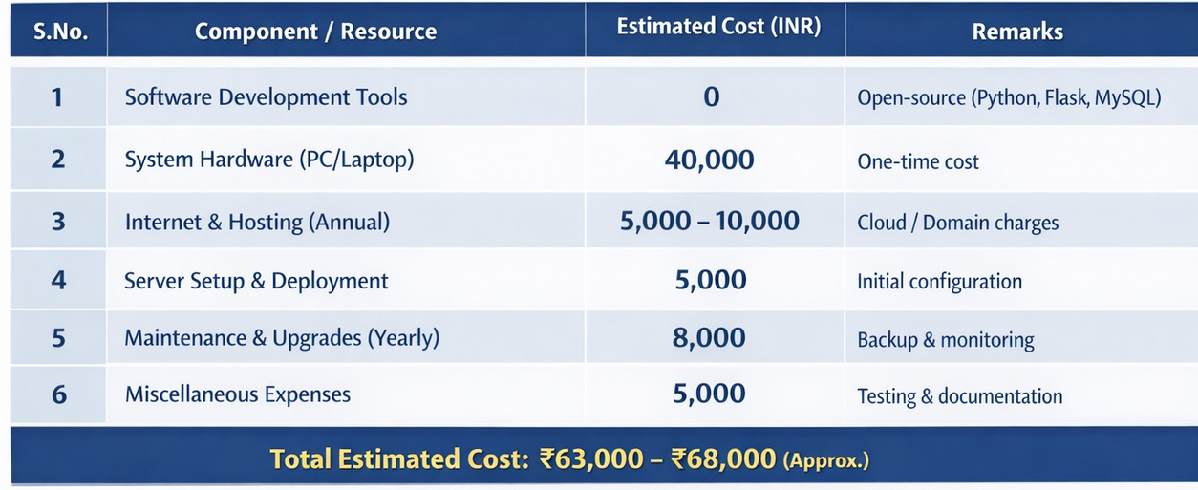
COST ANALYSIS (TENTATIVE)

Slide 7
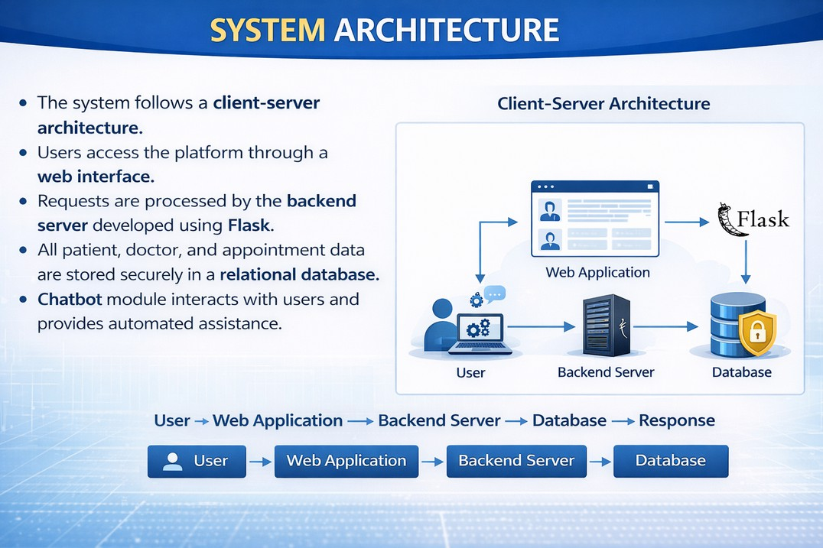
THE SYSTEM FOLLOWS A CLIENT–
WHERE
SERVER ARCHITECTURE
USERS ACCESS SERVICES THROUGH A WEB INTERFACE.
REQUESTS ARE PROCESSED BY THE BACKEND SERVER AND STORED SECURELY IN THE DATABASE.
THIS STRUCTURE ENSURES FAST RESPONSE, SECURE DATA HANDLING, AND SMOOTH HOSPITAL OPERATIONS.
7

Slide 8
KEY FEATURES & INNOVATION
Real-time online appointment booking
Role-based access for Admin, Doctor, and Patient Secure digital storage of medical records Anonymous mental health consultation feature Integrated chatbot for user support
Innovation lies in combining hospital management, privacy protection, and intelligent assistance in one unified platform.

Slide 9
IMPACT & FUTURE SCOPE
Impact:
Reduces waiting time in hospitals Improves operational efficiency Encourages mental health awareness Minimizes paperwork
Future Scope:
Mobile application development
AI-based appointment prediction system Online payment integration
Expansion to multi-hospital networks
9

Slide 10
CONCLUSION
The Smart Hospital Management System provides a practical and scalable digital solution for healthcare management.
It enhances efficiency, ensures privacy, and improves patient experience through automation and secure data handling.
The system supports modern healthcare needs and promotes accessible, technology-driven medical services.
10

